Slide 1

Advancing Low-Resource NLP: Contextual Question Answering
for Bengali Language Using Llama
Authors
Koshik Debanath Dept. of CSE, RUET. koshik.debanath@gmail.com | Sagor Aich Dept. of CSE, RUET. sagor.aichh@gmail.com | Azmain Yakin Srizon Assistant Professor, Dept. of CSE, RUET. azmainsrizon@gmail.com

Slide 2
Introduction
NLP advancements in high-resource languages vs low-resource languages[1]
300M+ Bengali speakers with limited QA systems [2].
Focus: Contextual QA for Bengali using Llama-3.2-3B

Slide 3
Problem Statement
Lack of Bengali QA datasets/resources [1]
Limitations of existing approaches (mBERT variants) [2].
Need for efficient LLM adaptation

Slide 4
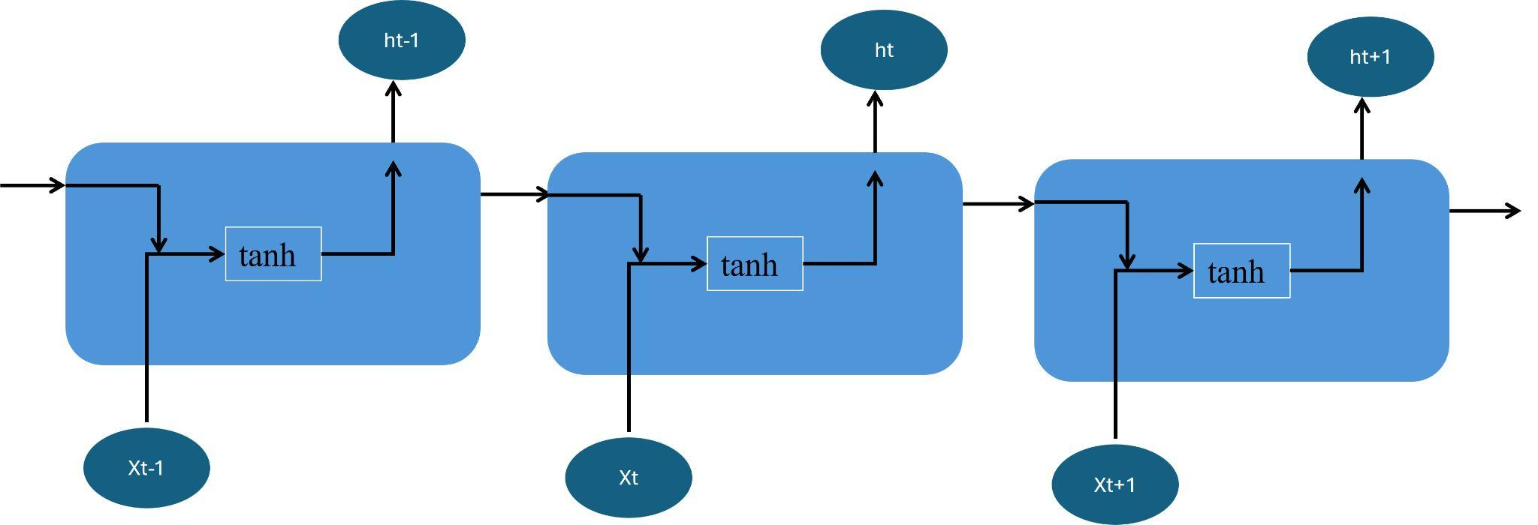
Related Work RNN/LSTM Approaches
Traditional sequence modeling [7]
Limitations in long-term dependencies
Fig. 1: Architecture of a Recurrent Neural Network
(RNN) [7].

Slide 5
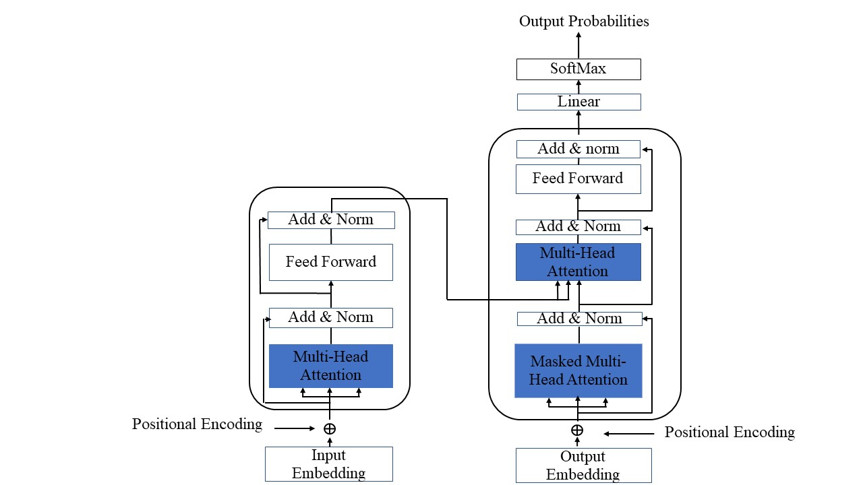
Related Work Transformer Evolution
BERT variants (mBERT, DistilBERT) [8].
PAL-BERT improvements [10].
Fig. 2: Architecture of the Transformer [6].

Slide 6
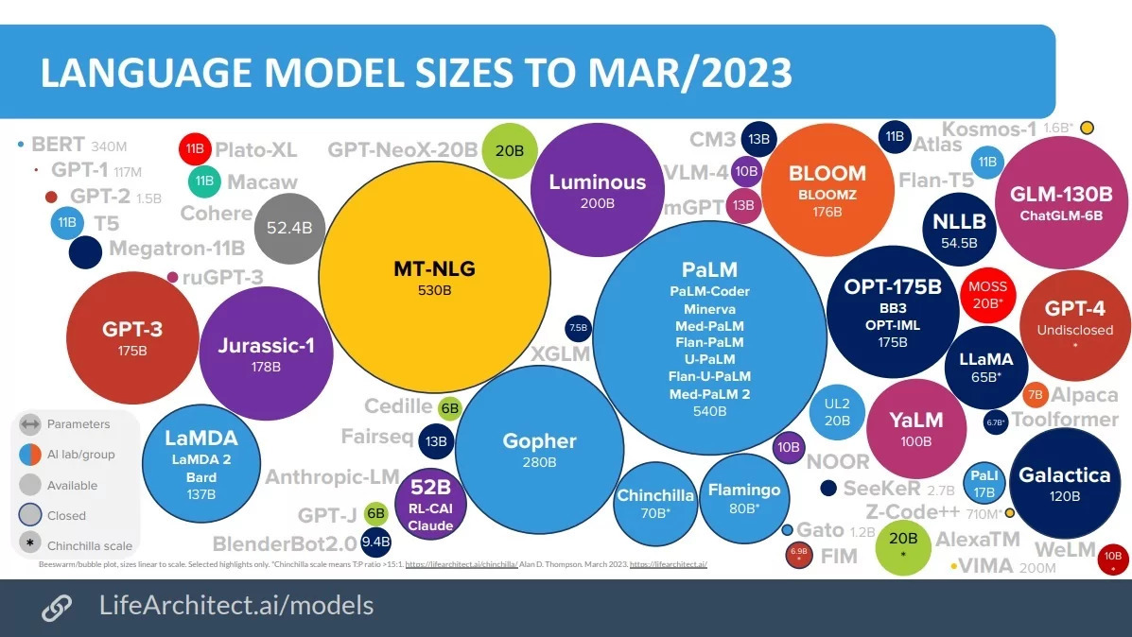
Related Work LLM Advancements
Llama model capabilities
Parameter efficiency comparisons
Fig. 3 : LLM Model Size Comparison

Slide 7
Research Questions
Can Llama-3.2-3B overcome Bengali data scarcity?
How does it compare to BERT variants?
Can synthetic data bridge resource gaps?

Slide 8
Objectives
Develop Bengali QA benchmark
Improve SOTA Performance by 4+ F1 points
Validate transfer learning efficacy

Slide 9
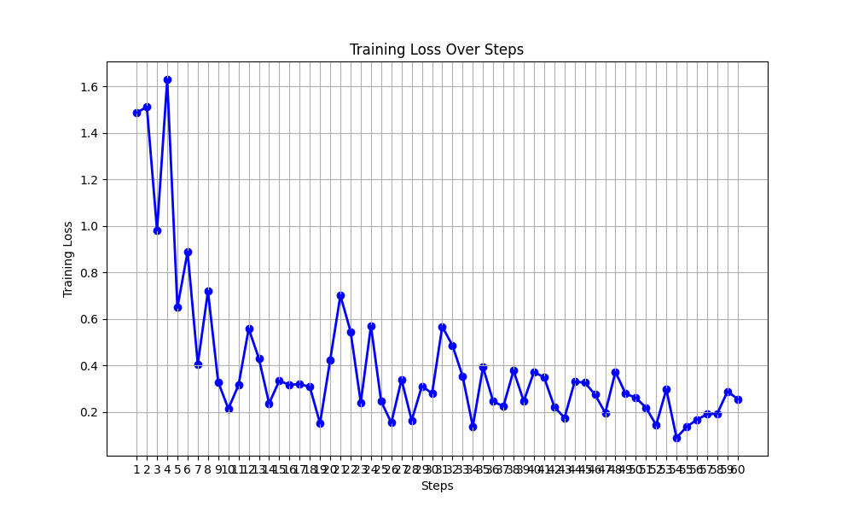
Outcomes & Impacts
42.77% F1 score (4.02% improvement) [2],[10]
Lightweight 3.4GB deployment
Educational/research applications
Fig. 4 : Training Loss Progression Across Steps

Slide 10
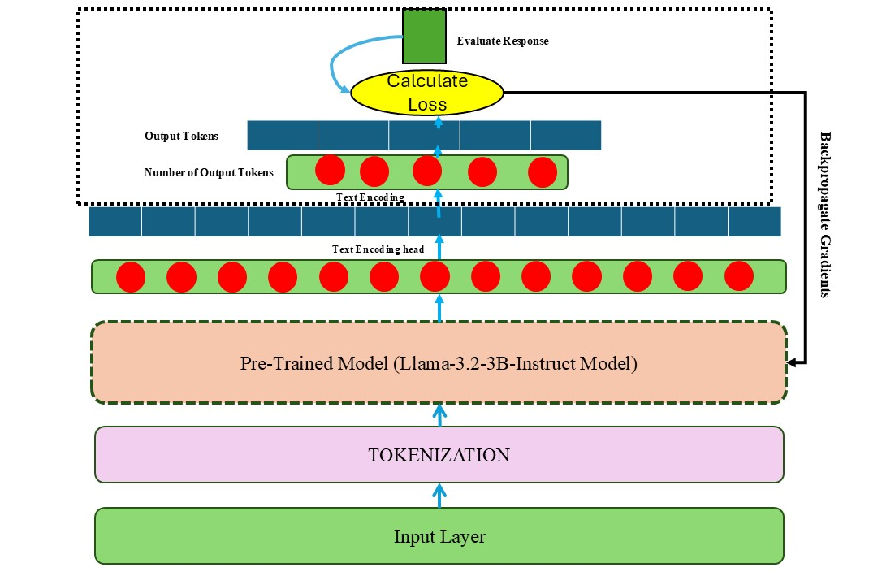
Methodology
Architecture Overview:
LoRA adaptation[8]
4-bit quantization[10]
Fig. 5 : Architecture of the Proposed Bengali Question
Answering System

Slide 11
Methodology
Training Process:
SQuAD 2.0 translation pipeline [4]
60-step fine-tuning
learning rate 0.0002
batch size 2 and
weight decay 0.01

Slide 12
Methodology
Evaluation Metrics(EM, F1 Score, Cosine Similarity, SAS):
Exact Match(EM): Exact Match (EM) measures the percentage of predictions that exactly match the ground-truth answer.It is calculated as the total number of exact matches divided by the total number of predictions, where F(xi) = 1 if the predicted answer matches the correct answer, and 0 otherwise.[2]
F1 Score: F1 Score is the harmonic mean of precision and recall. And it is computed as
F1 = 2 * Precision * Recall / (Precision + Recall)
Cosine Similarity Score: It’s quantifies the similarity between two vectors by calculating the cosine angle between them. And it’s calculated by A·⃗ B / ∥⃗ A∥∥⃗ B∥
Semantic Answer Similarity(SAS Score): The SAS score measures the semantic similarity between the predicted and reference answers. It is defined as SAS(A, R) = Sim(A,R) / 1+Dist(A,R) , where A and R are the predicted and reference answers, Sim(A, R) is a similarity function (e.g., cosine similarity), and Dist(A, R) is a distance metric. Higher scores indicate better semantic alignment.[9]

Slide 13
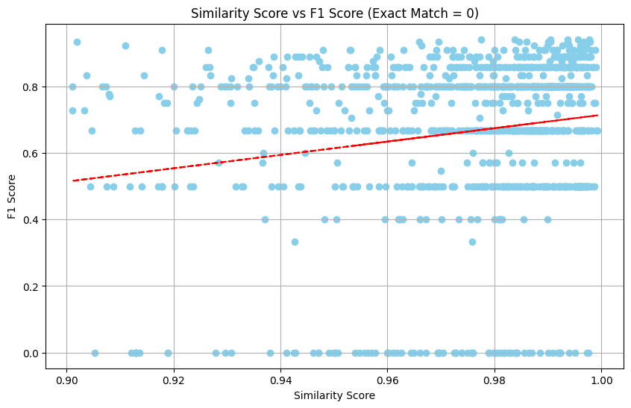
Experimental Results
Table 1 : F1 Score Comparison of previous studies and
Llama Model
Model | F1 Score(%)
BERT [1] | 36.38
DistilBERT [3] | 38.75
RoBERTa [5] | 19.16
Llama 3.2-3B | 42.77
Fig. 6 : Relationship between Similarity Score and F1 Score (Exact Match = 0), with a trend line indicating a positive correlation

Slide 14
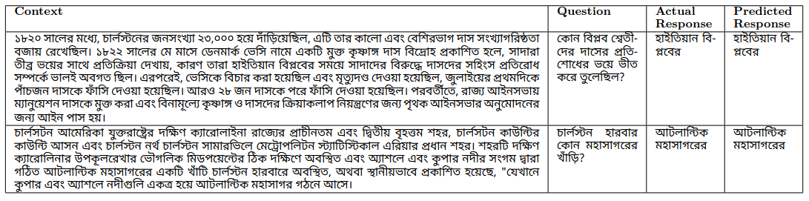
Experimental Results
Table 2 : Comparison of Actual and Predicted Responses (Correctly Predicted Answers)

Slide 15
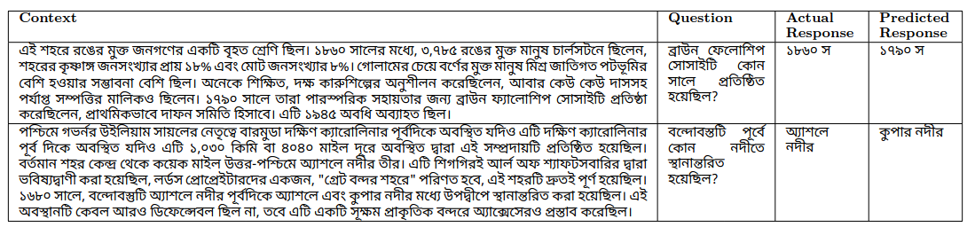
Experimental Results
Table 3 : Comparison of Actual and Predicted Responses (Incorrectly Predicted Answers)

Slide 16
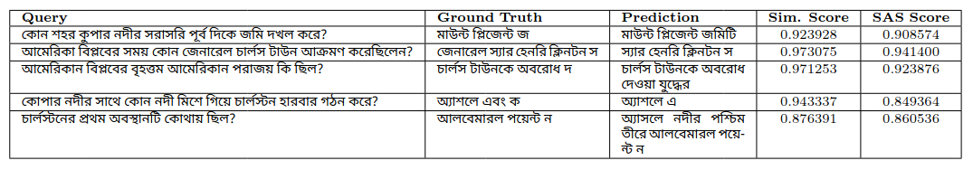
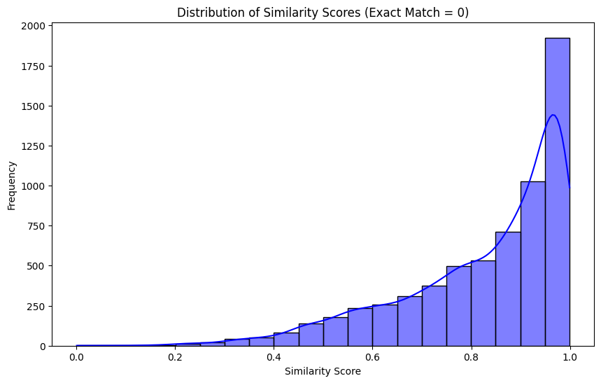
Experimental Results
Table 4 : Queries with zero exact match but high similarity and SAS scores, demonstrating preserved contextual meaning [9]
Fig. 7 : Distribution of Similarity Scores for Queries with No Exact Match (EM=0)

Slide 17
Conclusion
Proven LLM effectiveness for Bengali
Established new benchmark
Resource-efficient approach

Slide 18
Future Directions
RLHF integration
Multimodal expansion
Dialect adaptation

Slide 19
References
[1] J. Devlin et al., "BERT: Pre-training of Deep Bidirectional Transformers for Language Understanding," Proc. NAACL-HLT, 2019, pp. 4171–4186.
[2] S. Tahsin et al., "Deep Learning Approaches for Low-Resource Bengali Question Answering," IEEE Access, vol. 9, 2021, pp. 123456–123467.
[3] Y. Liu et al., "RoBERTa: A Robustly Optimized BERT Pretraining Approach," arXiv:1907.11692, 2019.
[4] P. Rajpurkar et al., "Know What You Don’t Know: Unanswerable Questions for SQuAD," Proc. ACL, 2018, pp. 784–789.
[5] V. Sanh et al., "DistilBERT, a Distilled Version of BERT: Smaller, Faster, Cheaper and Lighter," NeurIPS Workshop, 2019.
[6] A. Vaswani et al., "Attention Is All You Need," Adv. Neural Inf. Process. Syst., vol. 30, 2017.
[7] S. Hochreiter and J. Schmidhuber, "Long Short-Term Memory," Neural Comput., vol. 9, no. 8, 1997, pp. 1735–1780.
[8] Z. Lan et al., "ALBERT: A Lite BERT for Self-Supervised Learning of Language Representations," Proc. ICLR, 2020.
[9] M. Chen et al., "BERT for Question Answering on Low-Resource Languages," Proc. EMNLP, 2019, pp. 6355–6360.
[10] W. Zheng et al., "PAL-BERT: An Efficient Pruning Approach for BERT-Based QA Systems," IEEE Trans. Neural Netw. Learn. Syst., 2023.
[11] A. Conneau et al., "Cross-lingual Language Model Pretraining," Adv. Neural Inf. Process. Syst., vol. 32, 2019.

Slide 20
Thank You
If you have any query, please feel free to ask

